Slide 1

-: Inventory & Sales Management System :-
Name :JEET SARKAR
Student Code :BWU/MCA/26/039
Roll Number: 26102410035
Registration Number: 26102000157
Department: CSS

Slide 2
Introduction
A desktop application for managing products and shop sales.
Stores product ID, name, category, unit price and stock quantity.
Records sales and automatically adjusts remaining inventory.

Slide 3
Problem Statement
Small shops often maintain stock and sales in notebooks or spreadsheets.
Manual updates can cause inaccurate stock counts and billing errors.
Searching product details and identifying low stock can take time.
Owners may lack a clear view of product, category and monthly sales.

Slide 4
Project Objectives
Build a simple, user-friendly inventory and sales application.
Add, view and search products; manually increase stock.
Record sales, calculate bills and prevent sales beyond available stock.
Save product and sales records in CSV files.
Analyze sales with Pandas and display graphs using Matplotlib.

Slide 5
Scope of the Project
Target users: small shop owners and staff operating one desktop.
Coverage: products, stock updates, billing, sales history and analytics.
Limitations: no login, multi-user synchronization.

Slide 6
Literature Review / Existing System
Manual registers: inexpensive, but difficult to search and summarize.
Spreadsheet systems: flexible, but rely on correct manual entry and formulas.
Commercial POS systems: feature-rich, but may be complex for a small academic prototype.
Proposed approach: focused desktop interface with CSV persistence and basic analytics.

Slide 7
Proposed System
Dashboard: total products, stock, revenue and low-stock count.
Products: add new items and search the inventory list.
Stock Management: select product and add quantity.
Record Sale: validate stock, calculate amount and reduce stock.
Sales History and Analytics: review transactions and graphs.

Slide 8
Project Methodology & Technologies
Development approach: modular implementation, followed by feature testing.
Language: Python; GUI: Tkinter.
Core design: Product, Inventory, Sale, SalesManager and SalesAnalysis classes.
Storage: products.csv and sales.csv using Python csv module.
Analytics: Pandas; visualization: Matplotlib; IDE: Visual Studio Code.

Slide 9
Project Internal Structure:-
Tkinter GUI
Inventory / Product
SalesManager / Sale
Pandas + Matplotlib
products.csv
sales.csv

Slide 10
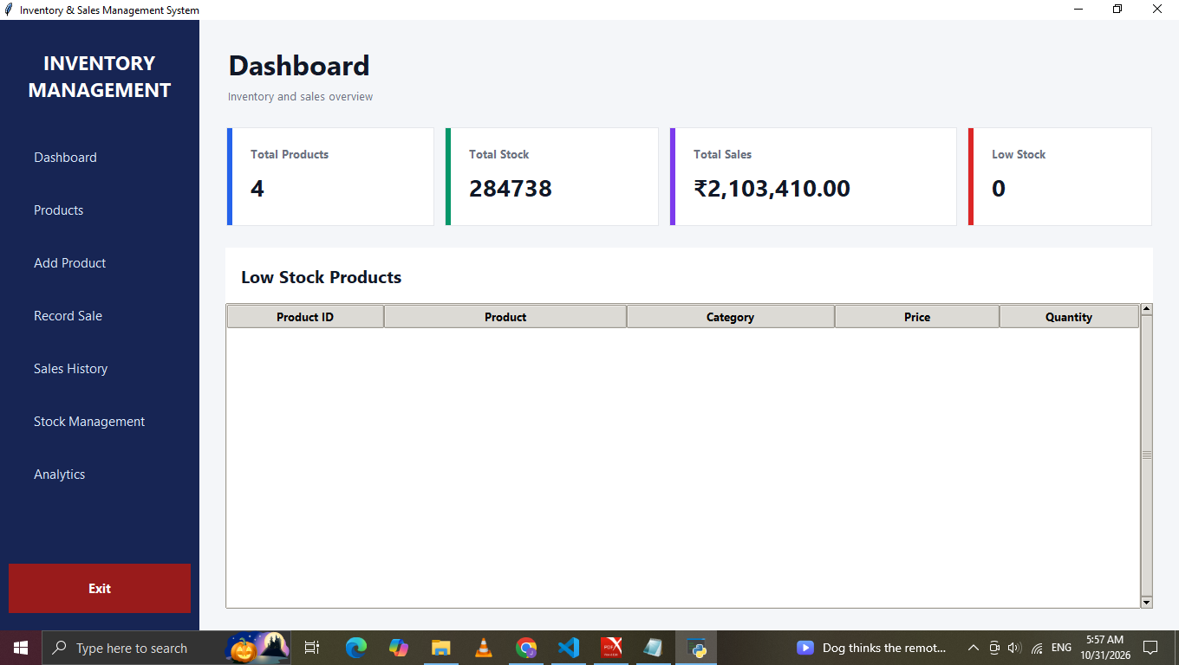
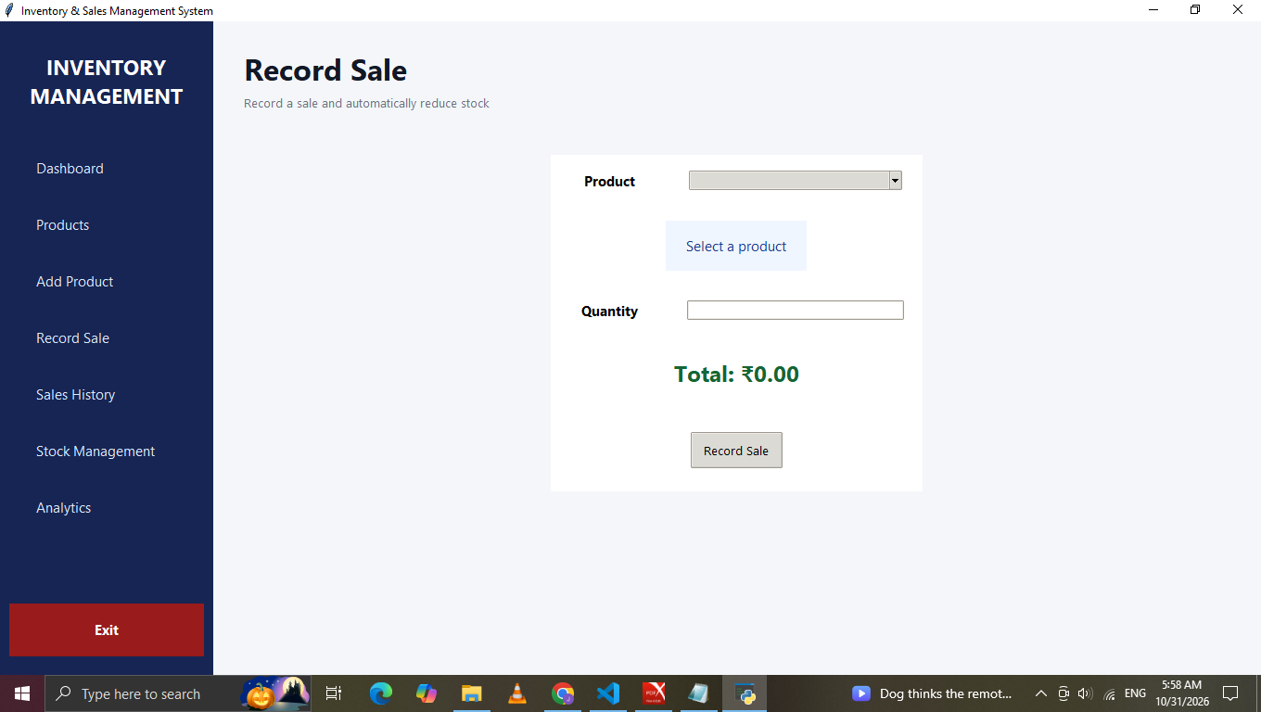
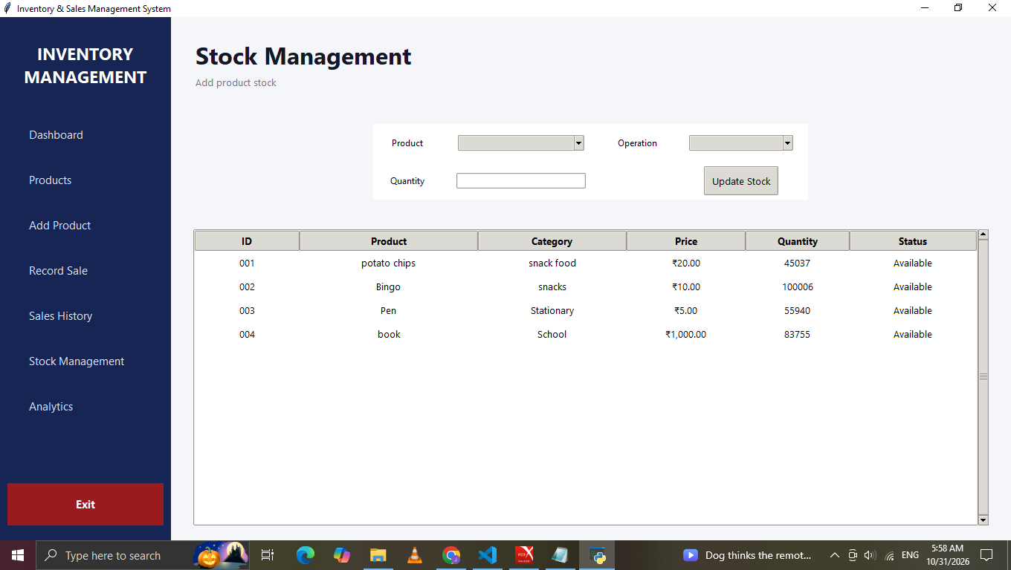
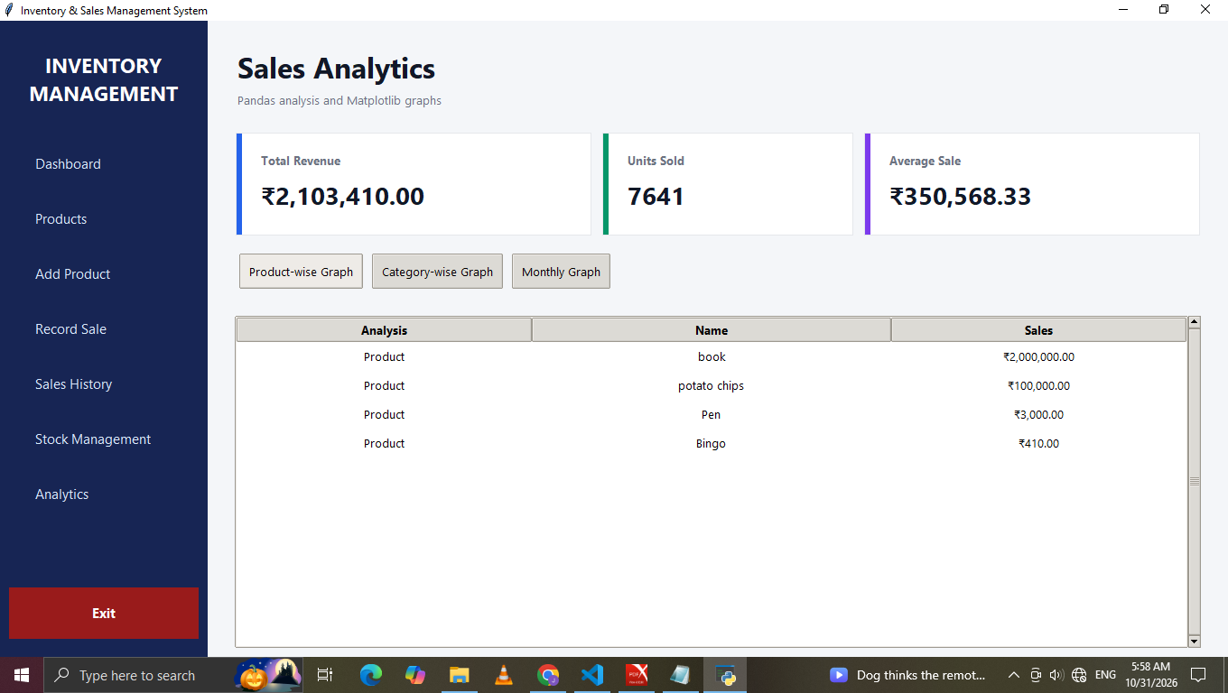
Implementation: Main Screens

Slide 11
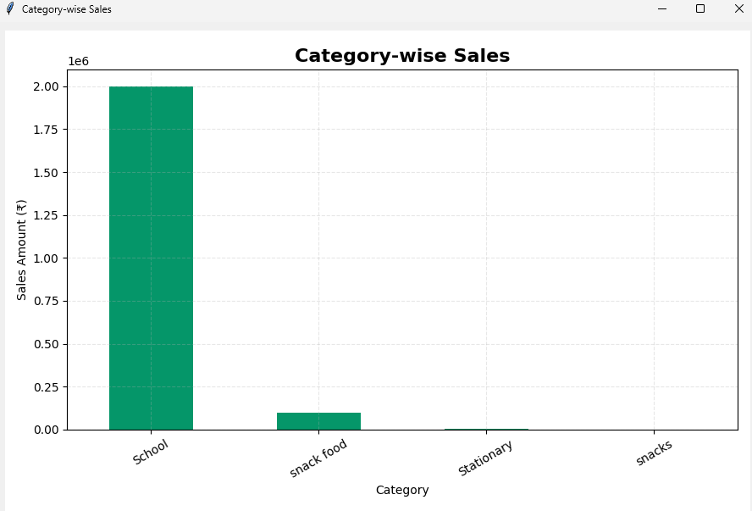
Testing and Results
Analytics

Slide 12
Conclusion
The project brings product, inventory and sales activities into one desktop interface.
CSV files provide straightforward local record storage.
Stock checks and exception handling reduce common data-entry mistakes.
Pandas and Matplotlib make sales information easier to interpret.
The project demonstrates Python OOP, file handling, GUI and data analysis.

Slide 13
Future Scope
User Security: Add login and role-based access.
Database Integration: Use MySQL or SQLite.
Sales Analysis: Improve sales performance tracking.
Cloud Storage: Access data from anywhere.
Support multi-user access, backup and automated reorder alerts.

Slide 14
References
Python Software Foundation. Python 3 Documentation-- https://docs.python.org/3/
Python Software Foundation. Tkinter Documentation--https://docs.python.org/3/library/tkinter.html
Python Software Foundation. CSV File Handling Documentation--https://docs.python.org/3/library/csv.html
Python Software Foundation. Datetime Module Documentation--https://docs.python.org/3/library/datetime.html
Matplotlib Development Team. Matplotlib User Guide--https://matplotlib.org/stable/users/index.html

